Slide 1

THE RAPID HIV SEROLOGY PROFICIENCY TESTING PROGRAM, KENYA Management and Use of PT Data Geoffrey Bundi Division of National Laboratory Services Kenya External Quality Assessment Scheme RTCQI BEST PRACTICES WORKSHOP Cape Town, South Africa June 3-7, 2024

Slide 2
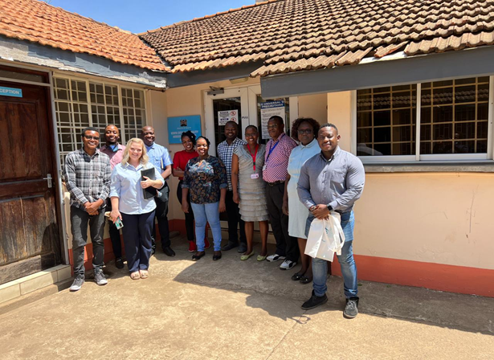
National Rapid HIV Proficiency Testing Scheme
Initiated :
Established in 2007 (facility-based) with 24 laboratories
Transitioned to individual-based PT scheme 2012
Provider:
National Public Health Laboratory through the Kenya External Quality Assessment Scheme (KNEQAS) in the HIV serology scope
Participants :
HIV testing services providers across the country
2
KNEQAS TEAM

Slide 3
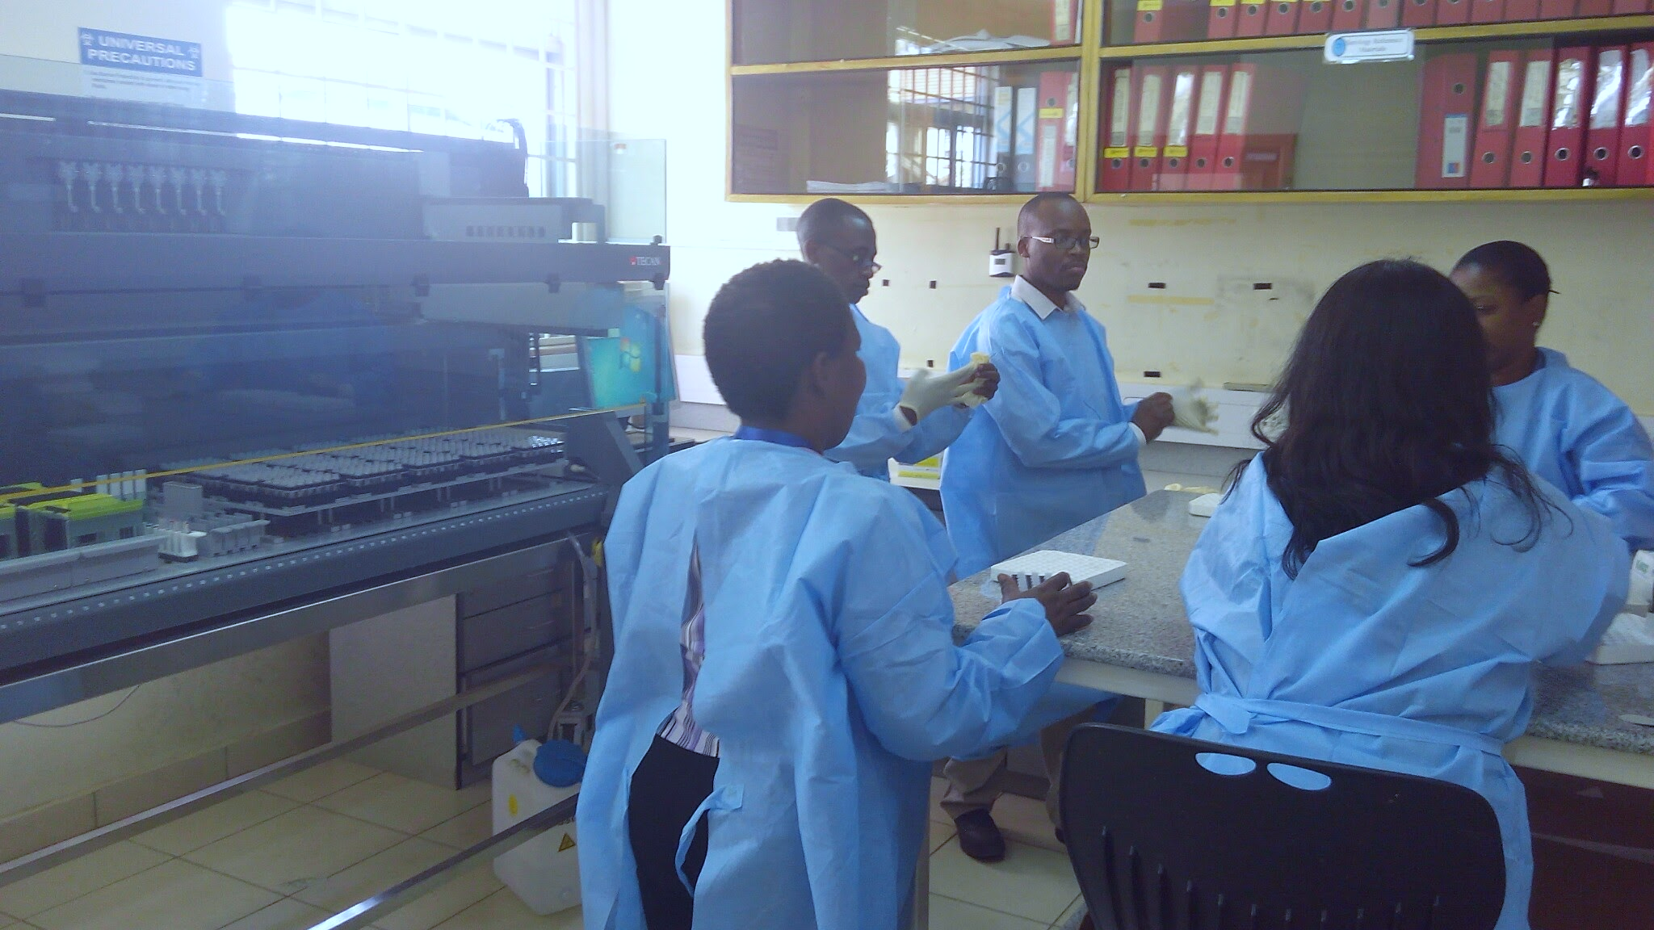
Workload
Enrollment of Participants
By 2024, 21,370 (82%) HTS providers enrolled against the programs approximated 26,000 registered personnel (86.4%)
Panel Production
Each participant gets six blinded Dried Tube Specimen (DTS) samples and 1 buffer (approx. 147,000 samples / round).
Scheme Schedule
Operates two rounds in a year-(June & October)
Data Processes
Return of test results – 14 days.
Provision of feedback reports – One Month
Corrective action
County plan corrective action after each round.
PT PRODUCTION
3

Slide 4
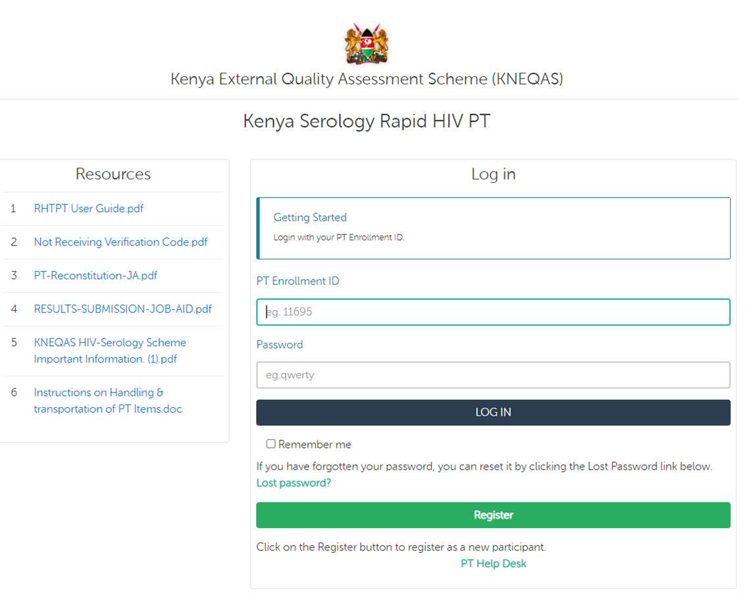
THE RAPID HIV PT ELECTRONIC SYSTEM (E-PT)
Enrollment of active HTS providers for each PT cycle
Keeps record of registered testers in PT over time

Slide 5
e-PT Tool Functionality
SMS notification to service providers
Opening of PT cycle
Enrolment into PT cycle
Dispatch of PT panels
Successful submission of PT results
Availability of feedback reports for download.
Notes:
Developed locally in collaboration with Strathmore University

Slide 6
The rapid HIV PT electronic system (e-PT)
Evaluates submitted results against set criteria
Provides access for downloading individual and aggregated performance
www.rhtpt.or.ke
Notes:
Developed locally in collaboration with Strathmore University

Slide 7
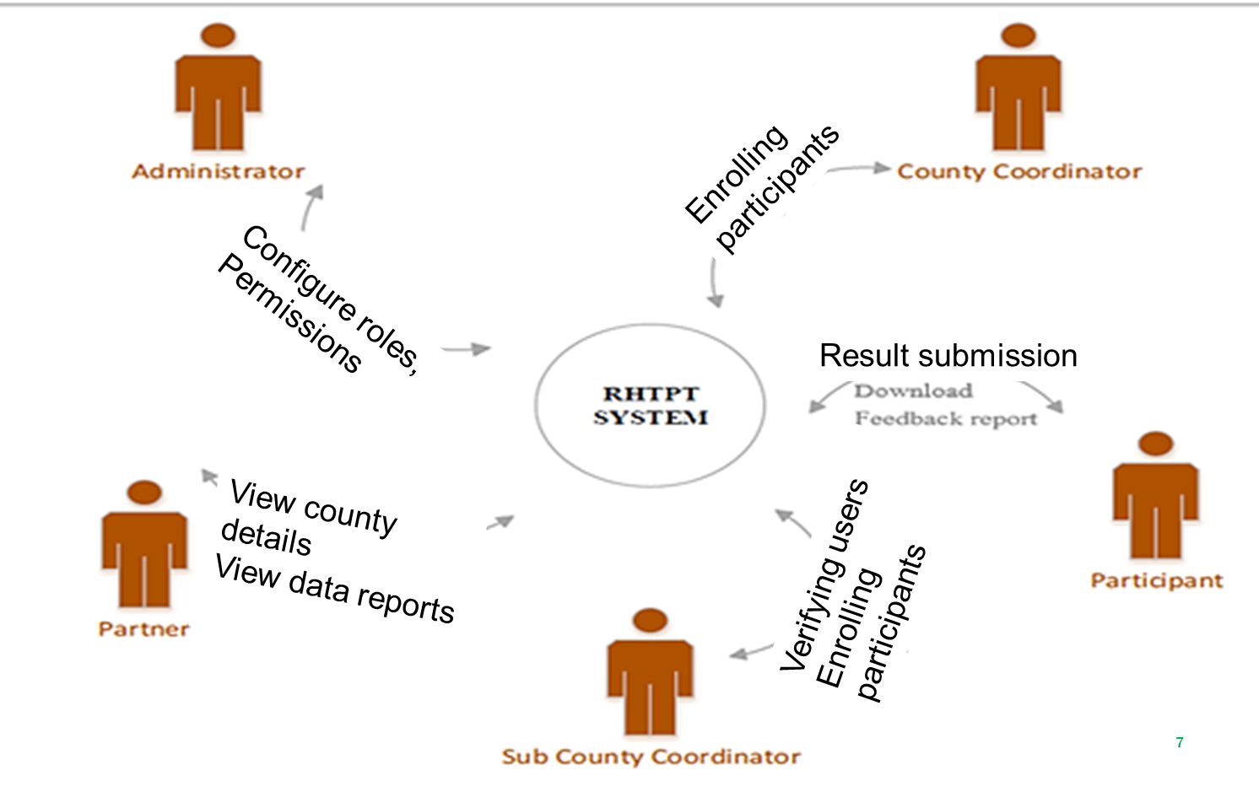
E-PT User roles
E-PT
Notes:
Success of the scheme is based that the system is accessibility by multiple stakeholders to register ,verify new and active participants , download reports.

Slide 8
Data Evaluation
Correctness of results
Ability to accurately determine HIV Sero-status of panel samples
Adherence to recommended testing algorithm
Test kits used
Testing sequence (serial testing)
Completeness of data
Adherence to the provided procedures.
Correct results interpretation
Completeness of results
Observance of kit expiry dates

Slide 9
County Participation Rates, 2023
Helps in targeting counties with low participation rates
Notes:
Helps in targeting counties with low participation rates
Explain why differed responses and low participation rates and any interventions to remedy. – Numbers participating and hence response largely based on number of testes per county. Low participation rates due to:
-RTK stockouts
-Lack of support from county/IPs in accessing PT panels
-HCW strikes

Slide 10
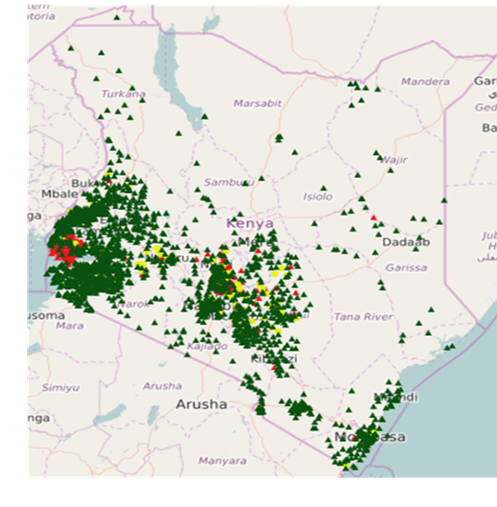
Overall Performance
10
Notes:
It took some time for supply chain to be streamlined after COVID.
Moving forward, the PT programs works closer with the supply chain team to ensure commodity availability before a PT cycle is sent out.

Slide 11
Performance by Program
Highlights of performance for different areas where testing is offered
Program | No of participants | % with Incorrect Results | % with Wrong Algorithm
PMTCT | 3501 | 9% | 2%
HBTC | 166 | 7% | 1%
PSC/CCC | 67 | 6% | 1%
PITC | 4548 | 5% | 1%
VCT | 2179 | 5% | 2%
LAB | 4931 | 4% | 2%
11
Notes:
Testing in PMTCT setting generally done by nurses. High workloads could be a reason for incorrect results.
Implications of incorrect results may result in transmission of HIV to unborn babies

Slide 12
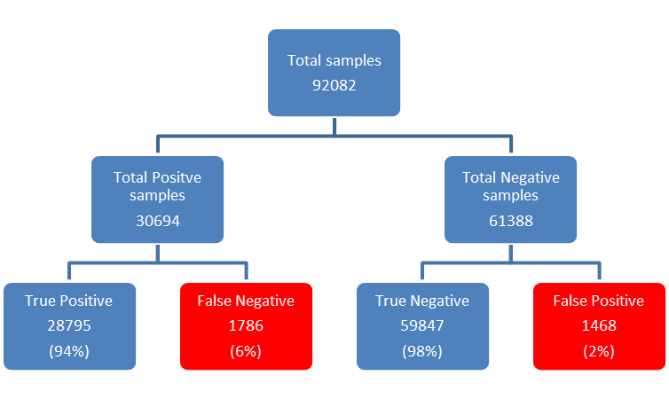
Performance by Samples Tested
Identifies:
Quality of samples provided
Challenges in ability to accurately determine HIV sero-status of samples
Samples prepared
Represents individuals who are HIV positive but given a negative result
Represents individuals who are HIV negative but given a positive result
12
Notes:
2023 data
12

Slide 13


Assay Performance
Informs the performance of the test kits used in the algorithm
 | TEST 1 (Screening test) |  | TEST 2 (Confirmatory test)
 | Sensitivity | Specificity | Sensitivity | Specificity
Sample 1 | 95.1% | 99.6% | 99.6% | 99.6%
Sample 2 | 93.3% | 99.6% | 93.4% | 99.5%
Sample 3 | 93.8% | 99.7% | 93.7% | 99.6%
Sample 4 | 97.4% | 99.6% | 94.2% | 99.6%
Sample 5 | 93.6% | 99.6% | 93.6% | 99.5%
Sample 6 | 94.5% | 99.7% | 94.5% | 99.7%
Notes:
Sensitivity - measures the ability of an antibody test to correctly identify individuals who have the condition (true positives). It is calculated as the proportion of true positive results among all individuals who actually have the condition. A higher sensitivity indicates a lower chance of false-negative results. In this case, the sensitivity of the screening test was lower resulting in a number of false negatives. This could also indicate the quality of the sample provided for PT
Specificity - measures the ability of an antibody test to correctly identify individuals who do not have the condition (true negatives). It is calculated as the proportion of true negative results among all individuals who do not have the condition. A higher specificity indicates a lower chance of false-positive results.

Slide 14
Turn-Around Times
TAT when using the Teleform system
TAT when using the e-PT

Slide 15
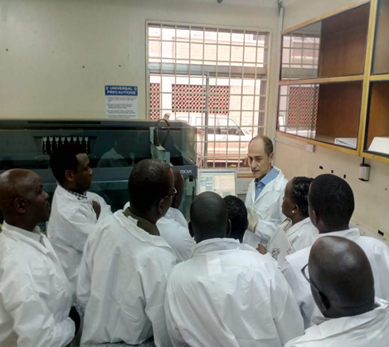

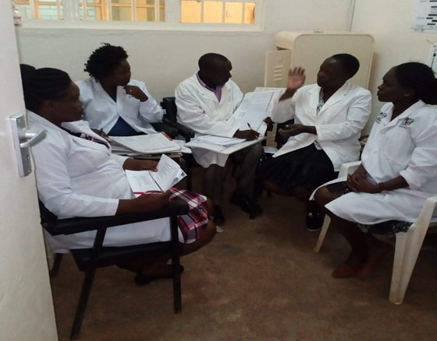

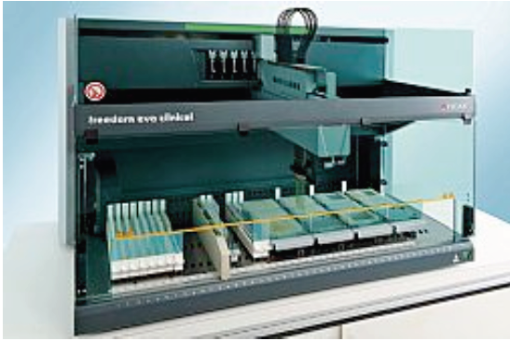
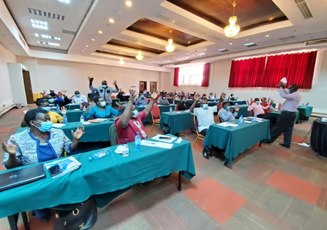
ACHIEVEMENTS
Informing Policy development
Mentorship and Training programs to facilities and County technical officers.
South-to south collaborations
ACHIEVEMENTS
Sensitization of stakeholders on their roles and effective program implementation mechanisms.
ISO 17043 accreditation
Automation of PT panel production process.

Slide 16
Lessons Learnt & Future Opportunities
PT data is useful in:
identifying gaps or challenges in the system
determining the impact of interventions implemented.
evaluating the efficacy and competency of testers at a particular moment in time
Future Opportunities
Capturing corrective action/preventive actions (CAPA) done in the electronic system to close the PT cycle.
System integration of all EQA scopes to ensure efficiency and scale-up (eg TB-LAM)
Continuous system development to respond to the current user needs.

Slide 17

Acknowledgements
Ministry of Health
County Governments
AMREF (National Laboratory Partner)
Clinical Implementing Partners
PEPFAR

